Slide 1
Platforms
Lecture 5B: Advanced Topics

Slide 2
Multiply Instructions
ARM assembly has several instructions for multiplication operations.
Unlike other arithmetic operations in that they have restrictions on the operands:
All source operands and the destination must be given as simple registers.
Immediate values and shifted registers cannot be used for operand two.
The destination and operand one must be different registers.
R15 (the Program Counter) cannot be used as a destination register

Slide 3
Multiply Instructions
MUL (Multiply) multiplies two 32-bit numbers (held in registers) and stores a 32-bit result in a destination register. If the operands are signed, the result will be signed also.
Multiplying two 32-bit numbers together gives rise to a 64-bit number. The MUL instruction only stores the lower 32 bits of the product.
MUL <destination>,<operand1>,<operand2>
MUL r0, r1, r2 ; r0 := r1 * r2 (bits 31 to 0 of product)

Slide 4
Multiply Instructions
MLA (Multiply-Accumulate) can add the product to another register acting as an accumulator.
The MLA instruction is useful for calculating running totals.
MLA <dest>, <oper1>, <oper2>, <accumulator>
MLA r0, r1, r2, r3 ; r0:= (r1 * r2) + r3
; (bits 31 to 0 only of result)

Slide 5
Multiply Instructions
The ARM has 4 instructions for multiplying 32-bit numbers and keeping all 64 bits of the product.
These place the most significant 32 bits in one register and the least significant 32 bits in another.
opcode <low-destination>, <high-destination>, <operand1>, <operand2>
UMULL r0, r1, r2, r3 ; r1:r0 := r2 * r3 (unsigned long multiplication)
SMULL r0, r1, r2, r3 ; r1:r0 := r2 * r3 (signed long multiplication)
UMLAL r0, r1, r2, r3 ; r1:r0 := r2 * r3 + (r1:r0) ; (unsigned multiplication with accumulate)
SMLAL r0, r1, r2, r3 ; r1:r0 := r2 * r3 + (r1:r0)
; (signed multiplication with accumulate)

Slide 6
Load/Store Multiple: Basics
The multiple register load and store instructions can load data from or store data to any subset of the sixteen general-purpose registers (i.e. r0 through to r15).
One register is used as a base address register storing the memory address location where values will be retrieved from or stored to.
Any registers can be used in these instructions, including r15 (the Program Counter).
Changing the contents of r15 forces a branch and, in most cases, should be avoided.

Slide 7
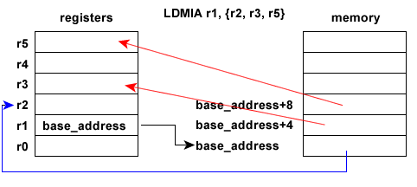
Load/Store Multiple: Basics
LDMIA r1, {r2, r3, r5} ; value in r1 is the base address
; set r2 equal to value at base address
; set r3 equal to value at base address +4
; set r5 equal to value at base address +8

Slide 8
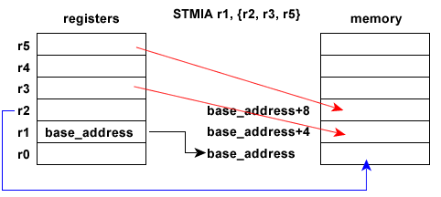
Load/Store Multiple: Basics
STMIA r1, {r2, r3, r5} ; value in r1 is the base address
; set value at base address equal to r2
; set value at base address+4 equal to r3
; set value at base address+8 equal to r5

Slide 9
Load/Store Multiple: Examples
In both load multiple and store multiple instructions, the base address register can be altered as part of the instruction.
Simply append an "!" to the base register.
LDMIA r1!, {r2 - r4} ; value in r1 is the base address
; set r2 equal to value at base address
; increment value in r1
; set r3 equal to value at new base address
; increment value in r1
; set r4 equal to value at new base address
; increment value in r1
; r1 is now r1+12

Slide 10
Load/Store Multiple: Examples
LDMIA stands for LoaD Multiple Increment After, where the base address register is incremented after it has been used.
The ARM has four possible options for multiple loads and stores:
Increment After - LDMIA and STMIA
Increment Before - LDMDB and STMDB
Decrement Before - LDMIB and STMIB
Decrement After - LDMDA and STMDA

Slide 11
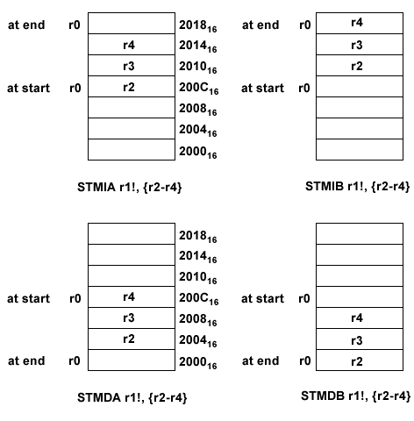

Slide 12
The Stack: Basics
A stack is a data structure that allows data to be stored and retrieved in an organised way.
It is "Last In, First Out" in that the last item placed on a stack is the first item to be removed.
A stack also refers to the portion of RAM that is being used to store temporary data.
When data is added to the stack, it is said to be pushed onto the stack.
When data is removed from the stack, it is said to be popped off the stack.

Slide 13
The Stack: Basics
In a PUSH operation, the contents of one or more registers will be placed onto the stack.
The memory address location where the first item is to be stored is held in another register (the stack pointer (SP))
On ARMs, r13 is normally used as the stack pointer, but anything other than r15 can also be used.

Slide 14
The Stack: Basics
The SP points to the first empty location in the stack
As data is pushed onto the stack, the SP is decremented so that it points to the next free location. (Stack grows downward in memory.)
The ARM architecture does not have specialised PUSH or POP instructions
Uses store multiple and load multiple instructions
STMDA r13!, {r2-r4, r7} ; push r2, r3, r4 and r7 onto the stack
; decrement r13 as each register is
; pushed onto the stack

Slide 15
The Stack: Basics
Registers are stored onto the stack in order from lowest to highest:
the lowest numbered register is placed in the lowest memory location accessed
and the highest numbered register in the highest memory location accessed.
This sequence is implemented regardless of the order they are specified in the instruction.

Slide 16
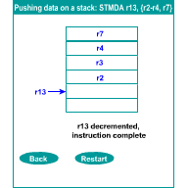
Pushing data on a stack

Slide 17
The Stack: Basics
To remove (POP) items from the stack entails loading memory into 1+ registers and adjusting the SP to reflect the freeing up of memory.
The stack pointer must be incremented before it is used as it points to the first empty location:
We increment because the stack grows downwards, so stored items will be in higher memory locations.

Slide 18
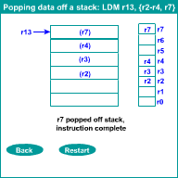
Popping data off a stack

Slide 19
Stack Types and Instructions
ARM supports four different stack types:
An Ascending stack grows upwards. It starts from a low memory address and, as items are pushed onto it, progresses to higher memory addresses.
A Descending stack grows downwards. It starts from a high memory address, and as items are pushed, progresses to lower memory addresses.
In an Empty stack, the stack pointer points to the next free (empty) location on the stack, i.e. where the next item to be pushed onto it will be stored.
In a Full stack, the stack pointer points to the topmost item in the stack, i.e. the location of the last item to be pushed onto the stack.

Slide 20
Stack Types and Instructions
ARM assembly has specific stack manipulation instructions with easier mnemonics.
STMEA r13!, {r0-r2} ; Push data onto an Empty Ascending Stack
LDMEA r13!, {r0-r2} ; Pop data off an Empty Ascending Stack
STMED r13!, {r0-r2} ; Push data onto an Empty Descending Stack
LDMED r13!, {r0-r2} ; Pop data off an Empty Descending Stack
STMFA r13!, {r0-r2} ; Push data onto a Full Ascending Stack
LDMFA r13!, {r0-r2} ; Pop data off a Full Ascending Stack
STMFD r13!, {r0-r2} ; Push data onto a Full Descending Stack
LDMFD r13!, {r0-r2} ; Pop data off a Full Descending Stack

Slide 21
Stack Types and Instructions
The stack manipulation instructions should be used in preference to the standard multiple-register load and store instructions. The stack instructions can be mapped to standard forms:
Stack Standard Type
STMFA STMIB Pre-increment store
STMEA STMIA Post-increment store
STMFD STMDB Pre-decrement store
STMED STMDA Post-decrement store
LDMED LDMIB Pre-increment load
LDMFD LDMIA Post-increment load
LDMEA LDMDB Pre-decrement load
LDMFA LDMDA Post-decrement load

Slide 22
Subroutine Basics
In high-level languages, modularisation (e.g. functions, procedures) simplifies programming.
In assembly language, such modularisation can be achieved using subroutines.
There are two steps to executing a subroutine:
calling the subroutine and
returning from the subroutine.

Slide 23
Subroutine Basics
Calling a subroutine involves:
saving the value of the PC (so that the subroutine can return to the correct place)
and then branching to the start of the subroutine.
Returning from a subroutine involves:
resetting the Program Counter to its saved value, thus automatically restoring the program execution to the instruction immediately following the original subroutine call.

Slide 24
Subroutine Basics
BL SUBROUT ; call subroutine SUBROUT
ADD r2, r0, r1 ; execution resumes here after subroutine returns
SUBROUT ; start of subroutine
MOV r15, r14 ; return from subroutine
BL (Branch-and-Link) saves the PC (r15) into r14. (r15 is pointing at the ADD instruction), and loads r15 with the subroutine's address, causing the program to branch (to the line labelled SUBROUT)
Once the subroutine is complete, returning simply requires moving the value in r14 back into the PC, (MOV r15, r14) and the program returns to the ADD instruction.
The BL instruction always uses r14 to store the return address. It is called the link register.

Slide 25
Nested Subroutines
The BL instruction always uses r14 to store the return address.
What if one subroutine calls another subroutine ?
There is also a second problem in that there are only so many registers available.
The subroutine (or its writer) won't necessarily know which registers are already used or may need to use those registers for its own computations.
The solution to both these problems is to use a stack to preserve the value of the return address and the contents of any other registers.

Slide 26
Nested Subroutines
BL Sub1 ; call first subroutine
; first subroutine returns to here
Sub1 STMED r13!, {r0-r3, r14} ; push working registers r0 to r3 ; and link register (r14) onto stack
… ; perform computations
BL Sub2 ; call second (nested) subroutine
; second subroutine returns here
LDMED r13!, {r0-r3, r14} ; pop old values of working registers ; r0 to r3 and r14 off stack
MOV r15, r14 ; return to main program

Slide 27
The Reset Pin
Occasionally computer software gets itself into such a mess that the only sensible thing to do is to "reboot" the system.
Microprocessors have an input connection called RESET(or something similar) that when activated initialises the processor and starts it running in a predetermined and safe fashion.
Whenever a logical low is detected on the ARM RESET, the program counter is reinitialized to 0x00000000 and the processor begins execution of the instructions found there.

Slide 28
The Reset Pin
The RESET input is normally used in two circumstances:
A reset button can be connected that brings the RESET pin voltage to 0 V and hence restarts the microprocessor. This is useful for emergency reboots.
When the power is switched on, suitable circuitry can ensure that the RESET pin voltage is held at 0 V for a short period so that the microprocessor starts up in a predefined state.

Slide 29
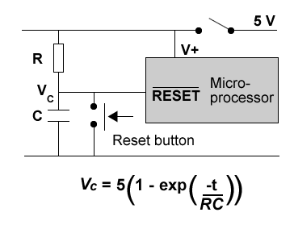
The Reset Pin
The values of R and C must be set such that VC does not rise above 2 V too quickly.
The critical time depends on how long it takes the processor to initiate the reset sequence.

